Slide 1
2025 Copley High School Cross Country
Parent Meeting
Coach Driscoll
Copley High School Head Boys and Girls Cross Country Coach

Slide 2
Cross Country Description
There is a no-cut policy in cross country. Every athlete makes the team and can run in all regular season meets. All our meets are contested on Saturdays, except the Revere Dual Meet, which is held on a weekday afternoon after school. Most of our meets are of an invitational format and will consist of numerous races. Depending upon the meet, the races might be divided into a varsity, junior varsity or open race. The normal distance of a high school cross country race is 5,000 meters (approximately 3.1 miles).

Slide 3
2025 Copley Cross Country Coaching Staff
Copley High School Head Coach Eric Driscoll
eric.driscoll@copley-fairlawn.org
Remind: cfhsxc23
Assistant Coach Sharon Rodriguez
Assistant Coach Laurel Labbe
Assistant Coach Christina Malpass
Assistant Elijah Fernstrum

Slide 4
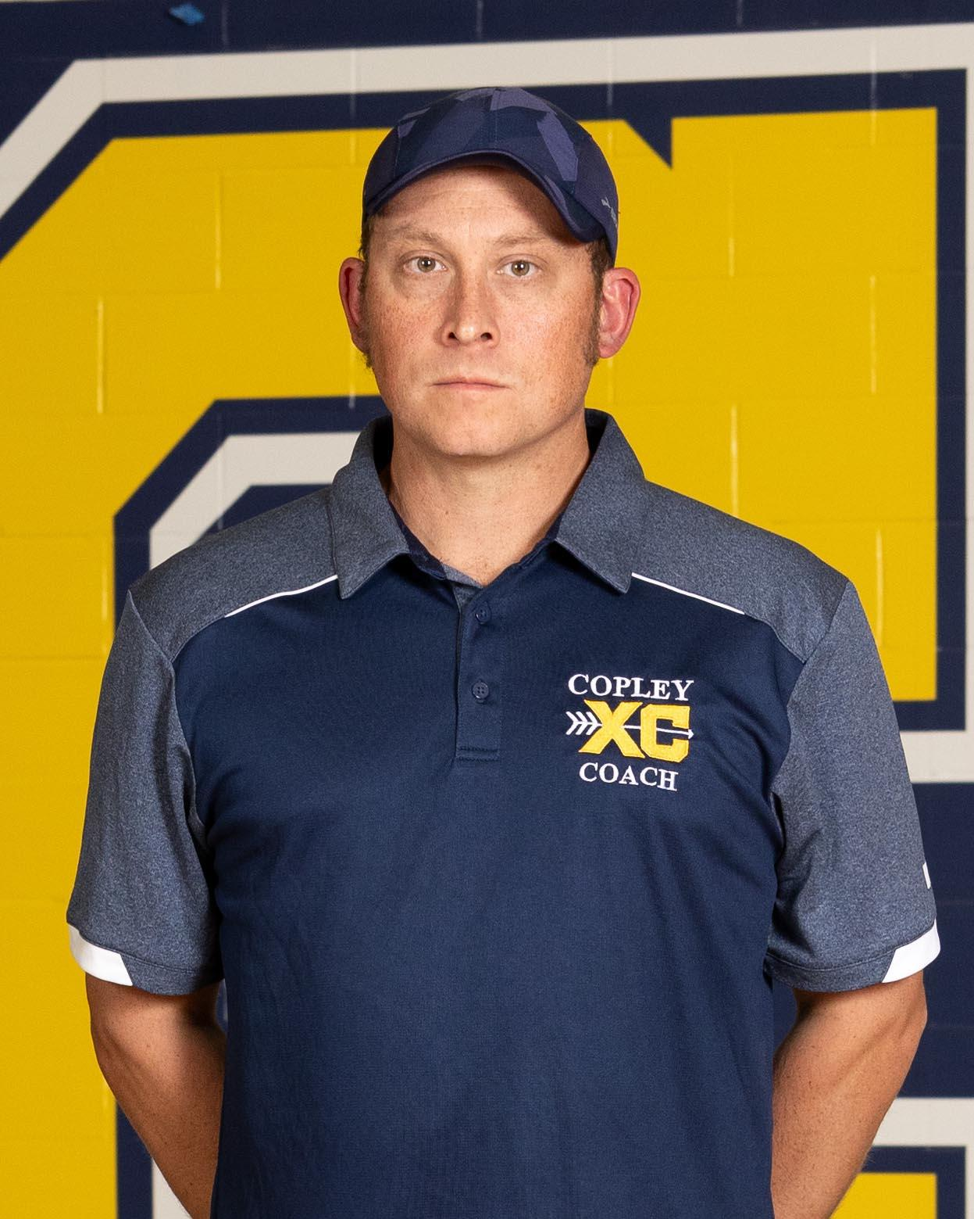
Head Coach HS Eric Driscoll
Coach Eric Driscoll is entering his third season as the Head Boys and Girls Cross Country Coach at Copley High School, following three successful years leading the Copley-Fairlawn Middle School cross country program. He also serves as the Assistant Track & Field Coach, specializing in distance events. In 2024, while serving as Interim Head Boys Track Coach, Coach Driscoll led the team to a Suburban League Championship.
Before coaching at the scholastic level, Coach Driscoll was the Director of the Copley Athletic Association (CAA) Youth Cross Country program, helping to grow a strong foundation for young runners in the community.
Outside of coaching, Coach Driscoll works as a Senior Test Automation Engineer for the Federal Reserve Bank of Cleveland. He holds a Master’s Degree in Computer Information Systems from Boston University (2018) and a Bachelor’s Degree in Political Science and Criminal Justice from The University of Akron (2004).
A lifelong runner, Coach Driscoll has completed five marathons and numerous half marathons. He is a proud member of both the Ohio Association of Track & Cross Country Coaches and the United States Track and Field & Cross Country Coaches Association, and holds a Cross Country Specialist Certification from USA Track & Field.
Coach Driscoll’s passion for running and coaching is also personal — his daughter Brynn will begin her freshman year at Copley High School this fall.

Slide 5
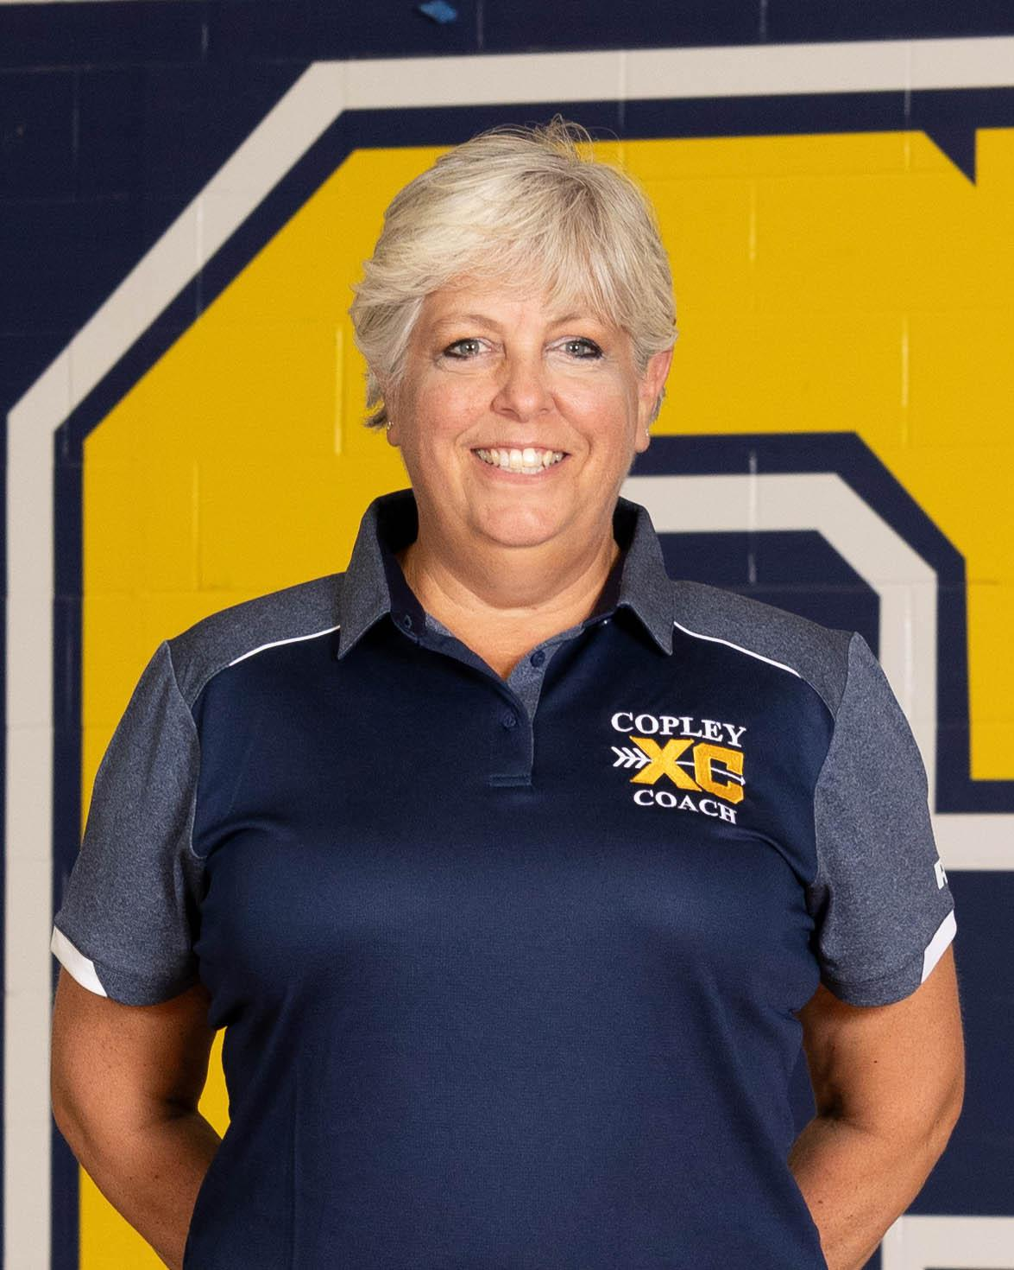
Assistant Coach Laurel Labbe
Coach Laurel Labbe is entering her third season as an Assistant Coach with the Copley Cross Country TEAM. A former varsity cross country athlete at Roxbury High School in New Jersey, she helped lead her team to an undefeated regular season during her senior year.
Coach Labbe earned her Bachelor’s Degree from Duke University and her Master’s Degree from the University of Massachusetts. A lifelong runner, she has completed ten half marathons and brings a strong passion for distance running and youth development to the program.
Outside of coaching, Coach Labbe teaches in the Woodridge Local School District and is their Choir Director. Laurel has had 3 children come through our Copley High School Cross Country program.

Slide 6
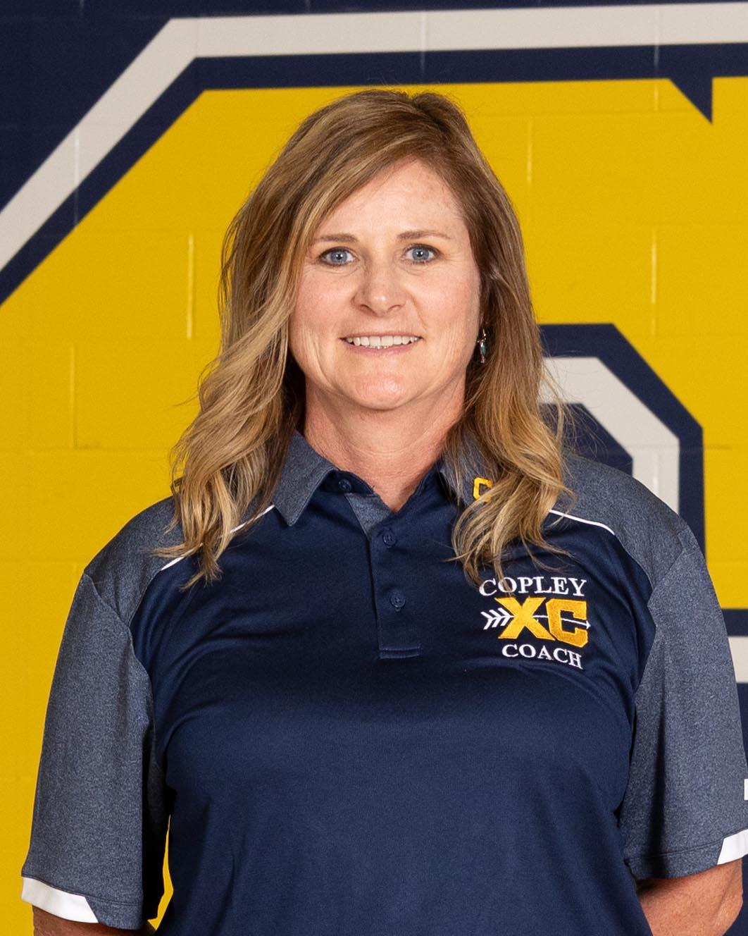
Assistant Coach Sharon Rodriguez
Coach Sharon Rodriguez is entering her second year on staff at Copley High School after previously serving as the Head Middle School Cross Country Coach for one season. She is a co-founder of Copley’s Youth Running Program and spent nine years coaching young athletes before making the transition to the middle school and now high school levels.
A graduate of Tallmadge High School, Sharon made history by founding the school’s first girls’ soccer team. She later earned her degree from The University of Akron. Born into the “Running Ritchies” family, Sharon has been running since early childhood and has completed a marathon, numerous half marathons, and countless 5Ks.
Outside of coaching, Sharon is the Physical Education teacher at Arrowhead Elementary and previously worked as a preschool teacher for over 10 years. Her son, Antonio, is a sophomore at Copley High School and competes in both Cross Country and Track & Field.

Slide 7
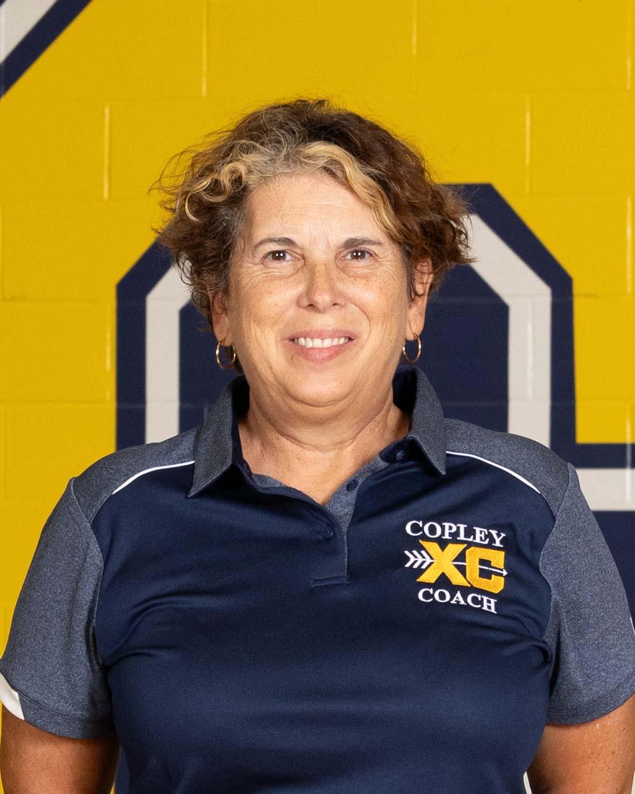
Assistant Coach Christina Malpass
Coach Christina Malpass is entering her third year on the coaching staff at Copley High School, assisting both the Cross Country and Track & Field programs after serving one season as an assistant coach at Copley-Fairlawn Middle School.
A standout runner herself, Coach Malpass was a member of Lima Shawnee High School’s 1983 state-championship cross country team. She went on to compete for Ohio University as a scholarship athlete in Cross Country and Track & Field. Since college, she has continued her competitive journey—completing numerous half marathons, full marathons, and even ultra-marathons.
Coach Malpass’s passion for the sport is shared at home; her son, Brayden, is a junior on the Copley Cross Country and Track Teams.

Slide 8
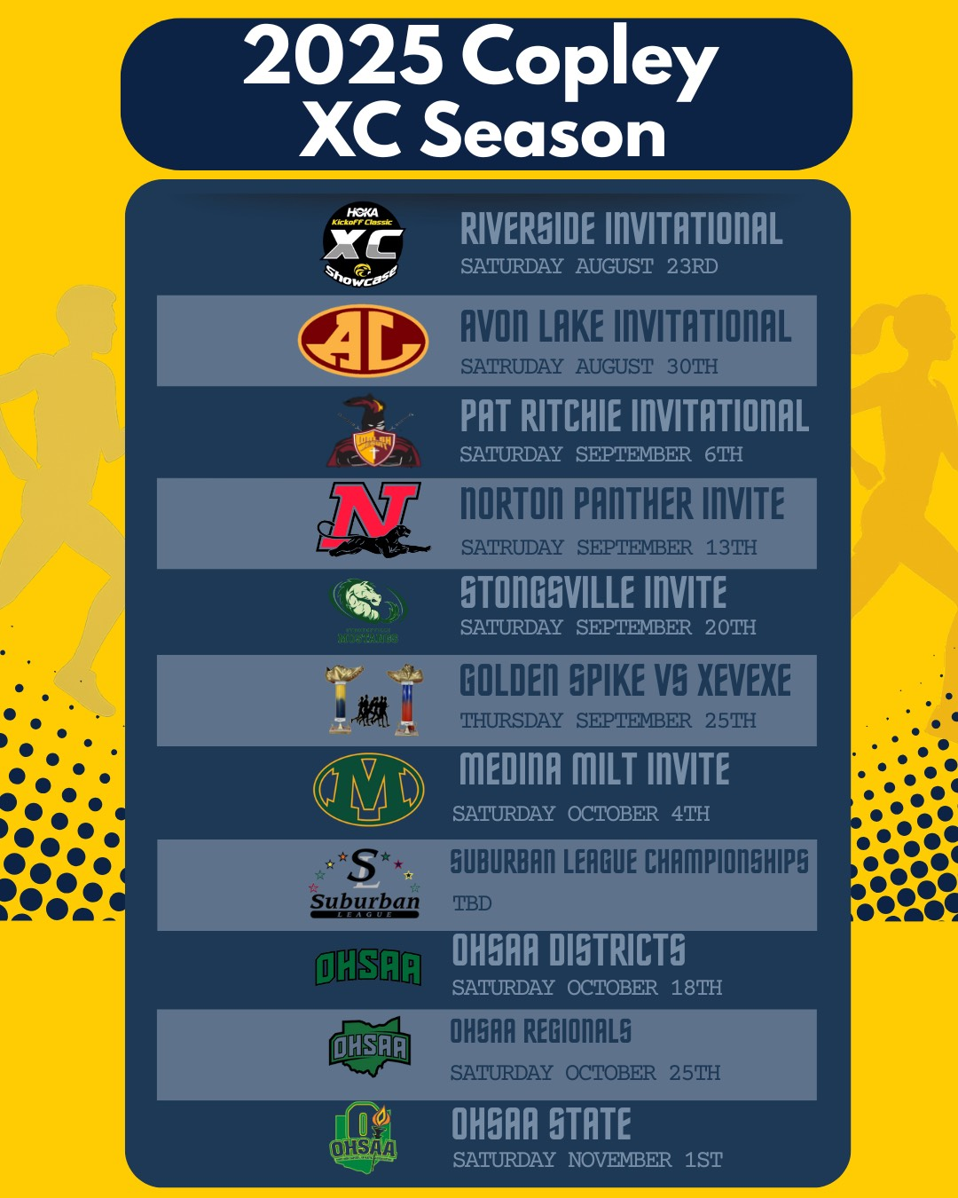

Slide 9
The Program Philosophy
IMPROVEMENT IN ALL OUR ATHLETES
WE ASK OUR ATHLETES TO FIRST BECOME CONSISTENT IN THEIR PERFORMANCES AND THEN TO STRIVE TO IMPROVE
DEVELOP THE ATHLETES TO ACHIEVE THEIR BEST PERFORMANCES AT THE END OF THE SEASON.
OUR OBJECTIVE IS TO HAVE EACH ATHLETE RUN THEIR FASTEST TIME IN THE LAST MEET OF THE SEASON.

Slide 10
Team Goals
Have fun! Enjoy practicing and competing.
Train judiciously to assure the peak performance occurs at the end of the season.
Be punctual and have good communication.
Stay Healthy – Get required sleep, nutrition and balance between school and activities.
COMPETE in our American Division of the Suburban League
COMPETE in OHSAA Post Season Districts - Regionals - State

Slide 11
Registration in Final Forms
All Athletes MUST Be Registered in Final Forms prior to first practice on 8/1/2025
Forms Must be Digitally Signed by Parent and Student
Physical Form Signed and Dated by Doctor, Athlete Cleared to participate and form Up To Date
Final Forms Information

Slide 12
How to Earn a Varsity Letter
Break the time of 19:00 (twice) Boys and 22:30 (twice) Girls
A senior who has actively participated in cross country for two or more years.
Run in the varsity race at an invitational (twice)
Run in the varsity race at conference championship or post season.
A student athlete that earned a letter the previous year but was forced to sit out due to injury.
In addition, an athlete must regularly attend practice, exhibit a positive attitude and display a strong work ethic. All student athletes must be present at the awards banquet to receive their letter.

Slide 13
Practice Schedule
HS Cross Country Practice/Meet Calendar

Slide 14
Training Plans and Recording Workouts
Option 1
Strava Group
V.02 Training Log
Option 2
Paper Training Log

Slide 15
District Policies
Athletic Code of Conduct
Eligibility Guide for Students/Parents
Special Team Rules

Slide 16
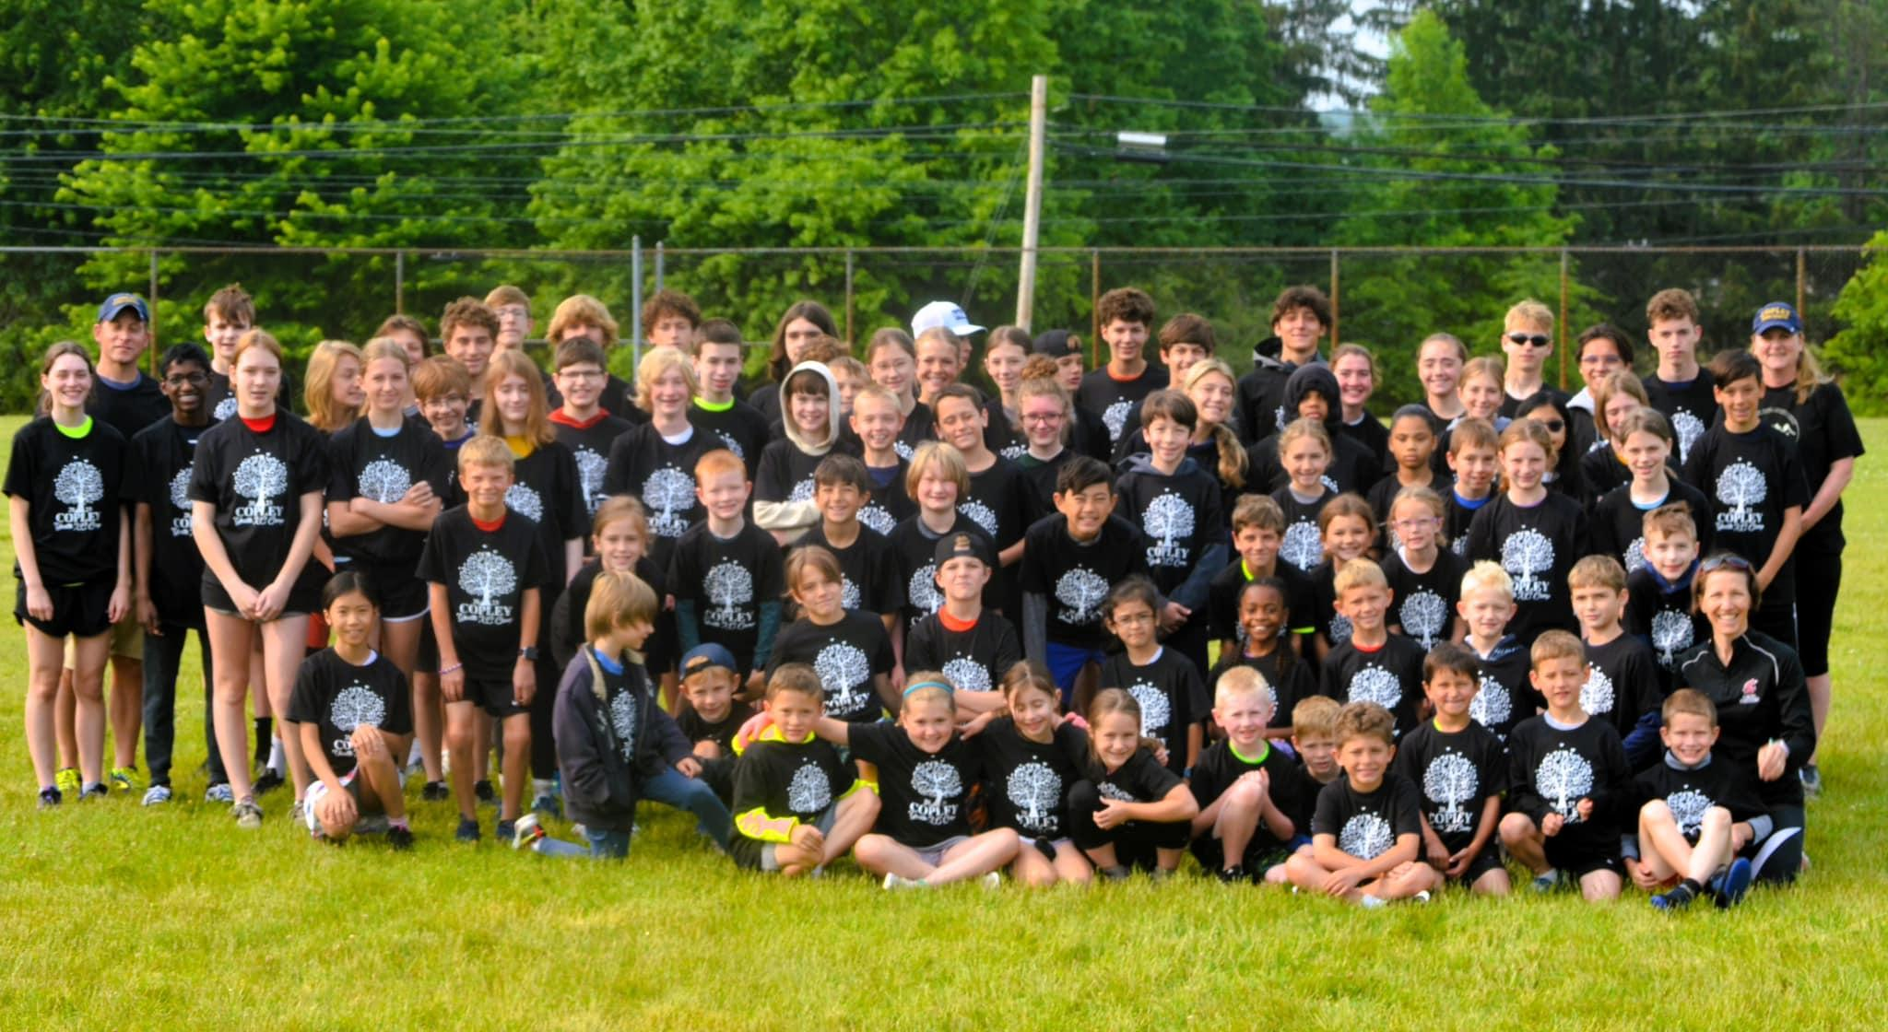
Fundraising
Mulch Madness (April – May)
Youth Cross Country Camp (One week in June)

Slide 17
Support Our Boosters
Please support the Copley Booster Club.
The Copley All Adult Sports Booster Club (CAASBC) promotes and supports all 24 athletic programs at Copley High School as well as all 13 athletic programs at Copley-Fairlawn Middle School. Your membership purchase helps the CAASBC raise funds to support these programs, in addition to providing annual scholarships. The CAASBC is made up of parents and community members with the primary purpose of promoting the benefits of interscholastic sport in our school system. For more information or to serve on the board, please contact the Copley High School Athletic Department.

Slide 18
Sports Medicine
Mark Stefanik Athletic Trainer
Dr. Kerwyn Jones Team Physician

Slide 19
Social Media
Purpose
Showcase the students and the program
Instagram
copleyhsxc
Facebook
copleyhsxc
https://www.facebook.com/copleyhsxc
Copley Athletics Website
Post Meet Stories
https://copleyathletics.org/

Slide 20
Fall Sports Banquet
End of each season there is a banquet at the High School
We Will Highlight The Teams Season
Honor Seniors
Hand Out OHSAA, Conference and Team Awards

Slide 21
Team Awards
Team MVP
Most Improved
Freshman of the Year
Charles Buck Award

Slide 22
Copley Girls Significant Team Awards & Accomplishments
Year | Conference Championship | District Championship Finishes | Regional Championships Finishes | State Championship Finishes
1986 |  | 1st
2000 | 1st
2006 | 1st
2007 | 1st

Slide 23
Copley Girls Postseason Individual Champions
District/Sectional Champ
Melissa Knabe 1985
Copley Cross-Country Top Performers - Google Sheets

Slide 24
Copley Girls All Ohio Performers
Copley High School Girls Cross Country All-Ohio Performers
NAME | PLACE | MARK | GRADE
1991
Andrea Park | 23rd | 19:48.00 | Senior
1984
Melissa Knabe | 15th | 19:37.00 | Senior
1982
Melissa Knabe | 13th | 18:53.00 | Sophomore

Slide 25
Copley Boys Significant Team Awards & Accomplishments
Year | Conference Championship | District Championship Finishes | Regional Championships Finishes | State Championship Finishes
1972 | 1st
1977 | 1st
1989 |  | 1st
1994 |  |  | 2nd | DII 10th
2000 | 1st |  |  | DII 7th
2002 | 1st | 1st |  | DII 16th
2003 | 1st
2004 | 1st
2005 | 1st
2023 | 3rd | 7th

Slide 26
Copley Boys Postseason Individual Champions
Regional Champ
Pupino | 2011
District Champ
Ron Ilg | 1993
Ron Ilg | 1994
Copley Cross-Country Top Performers - Google Sheets

Slide 27
Copley Boys All Ohio Performers
Copley High School Boys Cross Country All-Ohio Performers
NAME | PLACE | TIME | GRADE | Division
2011
Nick Pupino | 4th | 15:27.65 | Senior | I
2007
Chris Fallon | 7th | 15:41.32 | Senior | I
1994
Ron Ilg | 19th | 16:47.00 | Junior | II
1993
Ron Ilg | 15th | 16:16.00 | Sophomore | II
1992
Ron Ilg | 20th | 16:23.00 | Freshman | II
1986
Mike Koch | 2nd | 15:32.00 | Senior | AA
1984
Mike Koch | 17th | 16:37.00 | Sophomore
1982
Patrick Farrell | 7th | 15:43.00 | Senior | AAA
Updated 10/26/21

Slide 28
Other Information
Website for College Bound Athletes Eligibility Resource Guide

Slide 29
Any Questions
Please feel to reach out to me if you think of any questions.
eric.driscoll@copley-fairlawn.org
Remind: cfhsxc23

